Slide 1
Recipe site traffic
Clain Rudolph B. Asuncion

Slide 2
Business goal
Accurately predicting high-traffic recipes for homepage placement
Replacing intuition-based selection with a scalable, data-driven approach
Driving sustained traffic growth through improved content curation

Slide 3
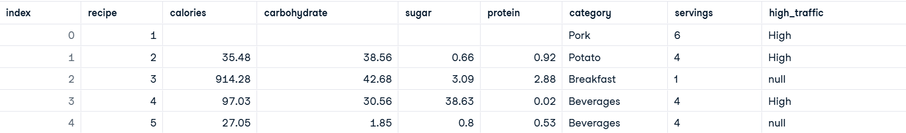
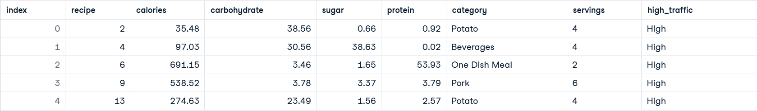
Data Cleaning
Initial Data:
Cleaned Data:

Slide 4
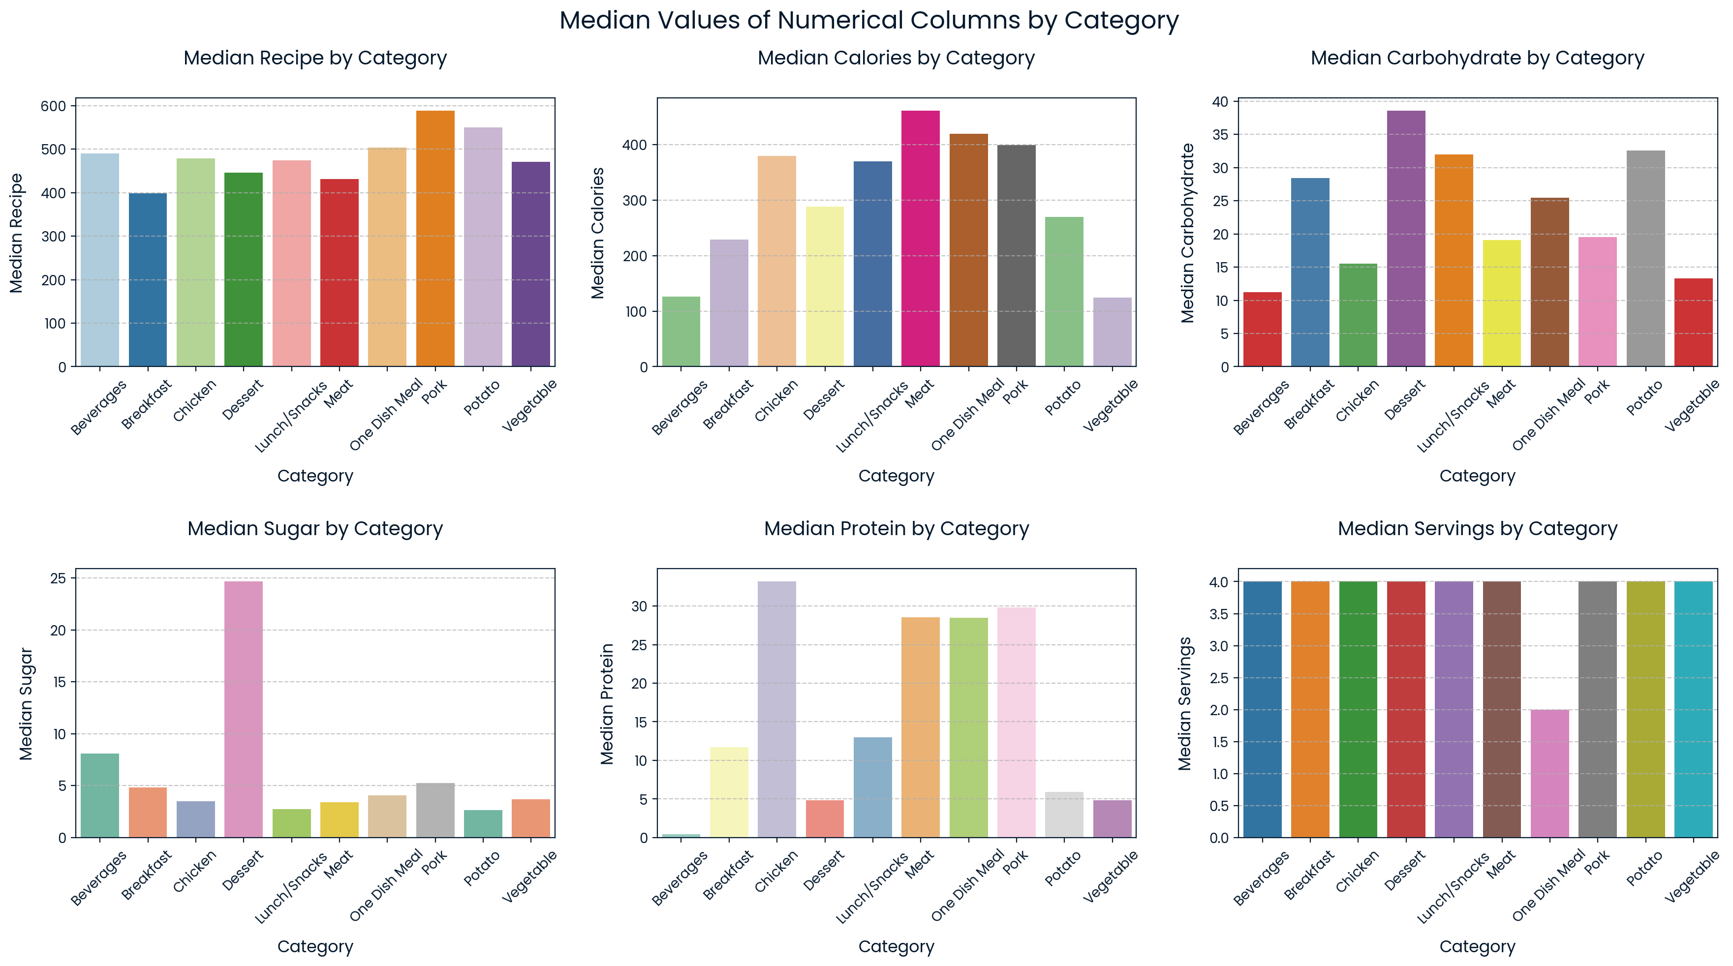
EXPLORATORY ANALYSIS

Slide 5
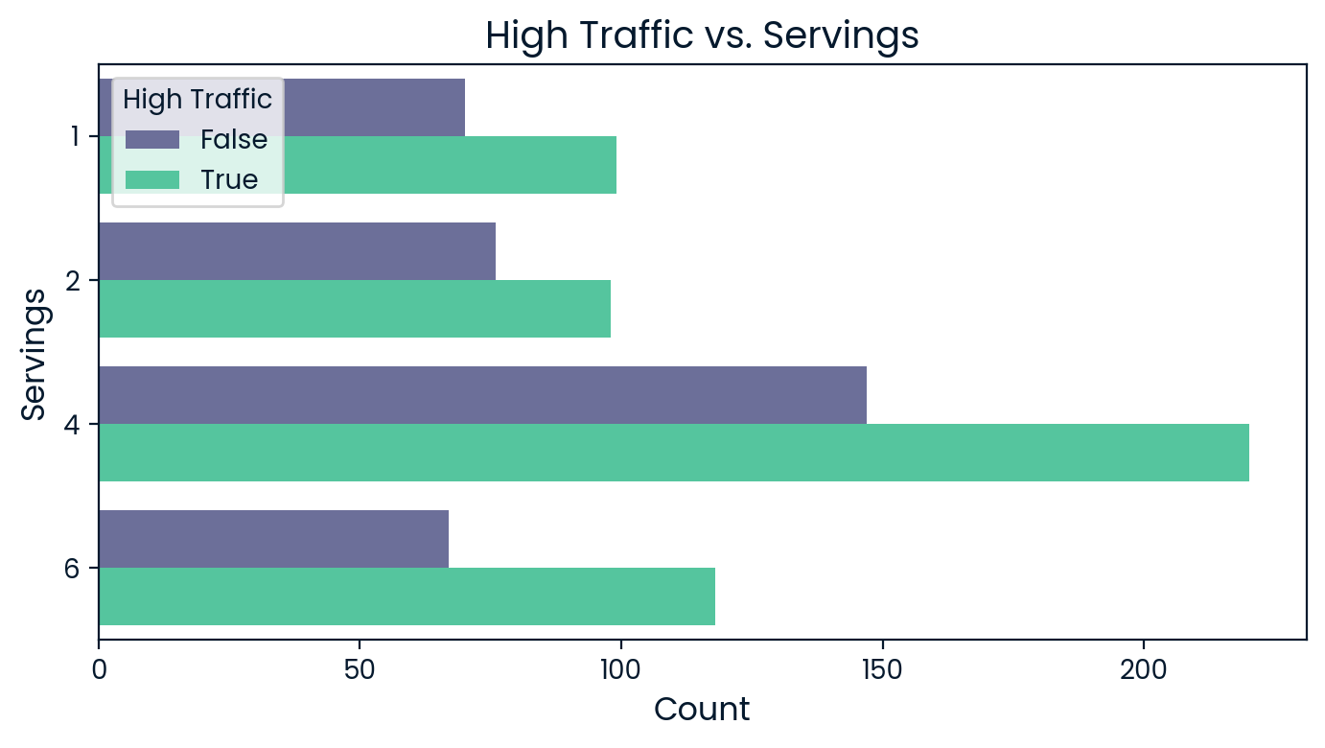
The count plot shows that recipes with higher servings—especially 4 and 6—are more common in high-traffic categories, suggesting that popular recipes tend to serve more people. This highlights a link between serving size and recipe visibility.

Slide 6
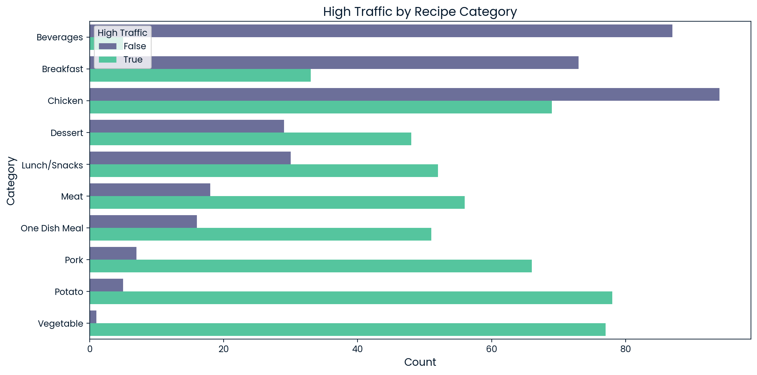
This count plot shows how high-traffic recipes are distributed across different recipe categories. From the graph, we can identify which categories attract the most high-traffic recipes, as well as those with relatively low traffic. It also highlights whether high traffic is spread evenly across categories or concentrated in specific ones, giving insight into which recipe types are most popular.

Slide 7
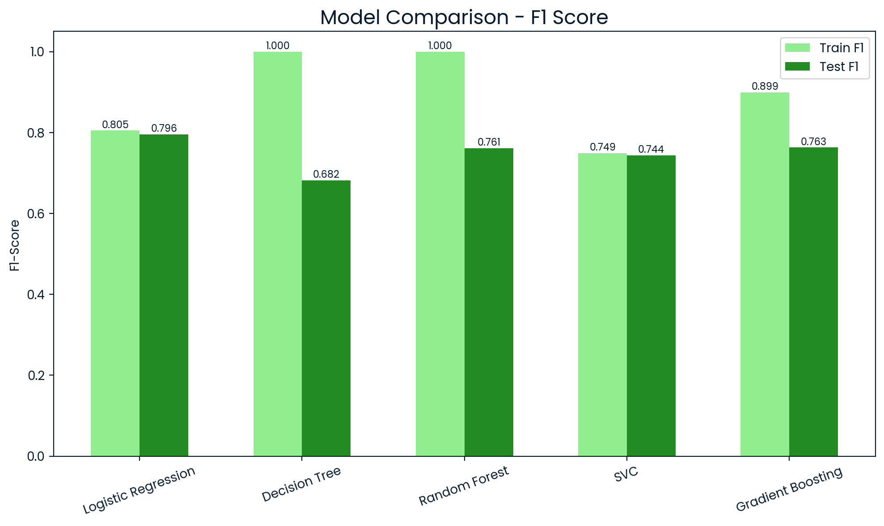
Model comparison

Slide 8
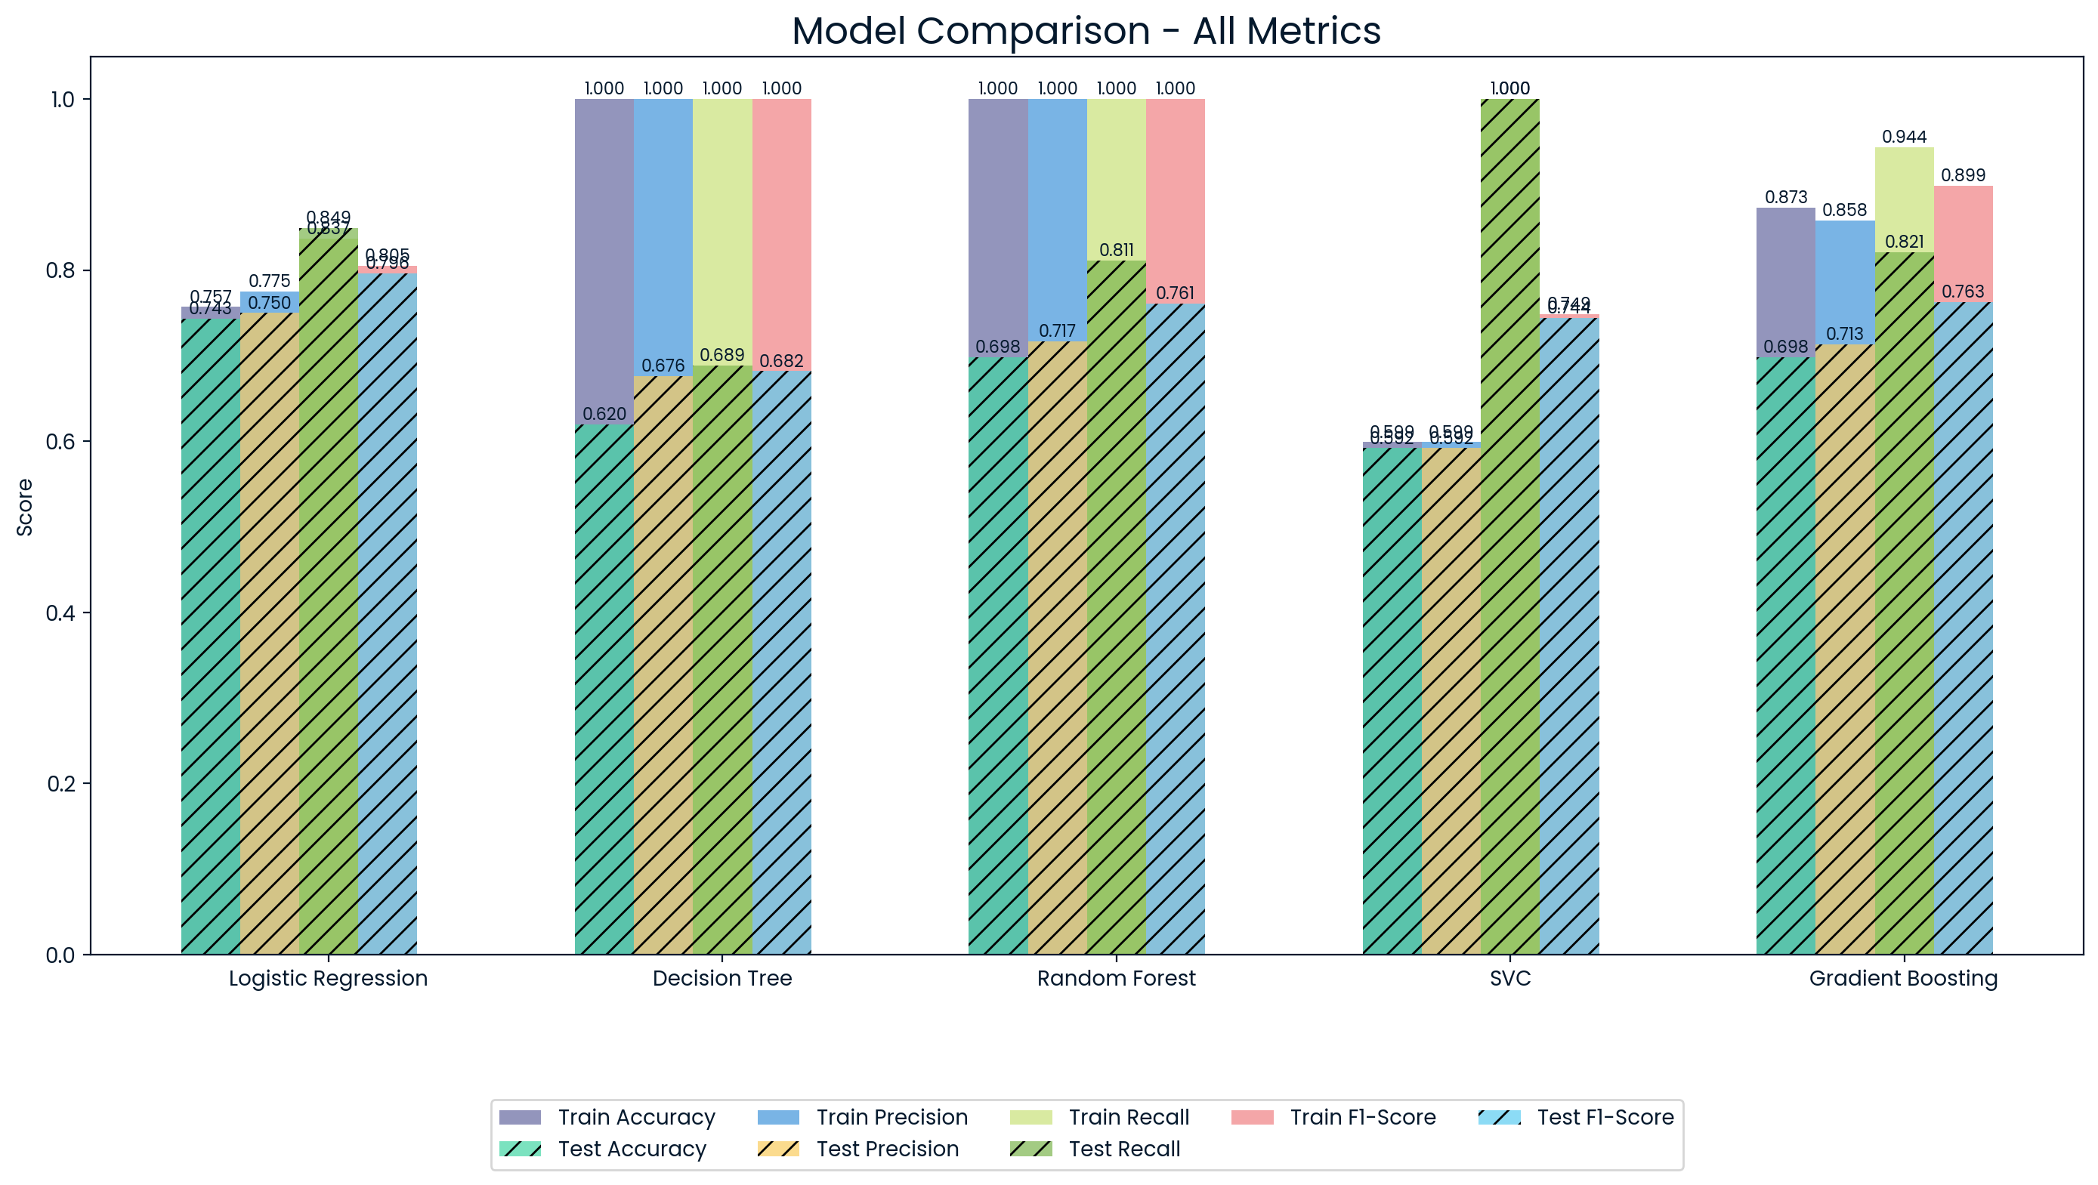

Slide 9
OUtcomes
The Logistic Regression model is performing better.
Model Name | Accuracy | Precision | Recall | F1-Score
Logistic Regression | 74% | 75% | 85% | 80%
Decision Tree | 62% | 68% | 69% | 68%
Random Forest | 70% | 72% | 81% | 76%
SVM | 59% | 59% | 100% | 74%
Gradient Boosting | 70% | 71% | 82% | 76%

Slide 10
Key findings
Nutritional features are right-skewed with clear outliers, especially in sugar and calories.
Recipes with higher calorie and sugar content tend to receive more traffic.
Logistic Regression achieved the best balance (Accuracy 76%, F1-Score 80%), outperforming Decision Tree, Random Forest, SVM, and Gradient Boosting.
Identifying high-traffic recipes enables better promotion and increased audience engagement.

Slide 11
Recommendations
Deploy Logistic Regression as Primary Model: It consistently delivers strong accuracy and F1-scores across training and test sets.
Reliable Generalization: Demonstrates minimal overfitting, making it well-suited for real-world prediction tasks.
Low Maintenance for Production: Performs well without extensive hyperparameter tuning or complex preprocessing.
Supports Scalable Monitoring: Easily integrates into a retraining pipeline to adapt as new recipe data becomes available.

